Slide 1
Numerical Computing Faculty: Adnan Ullah Khan College of Computing & Information Science Lecture :02

Slide 2
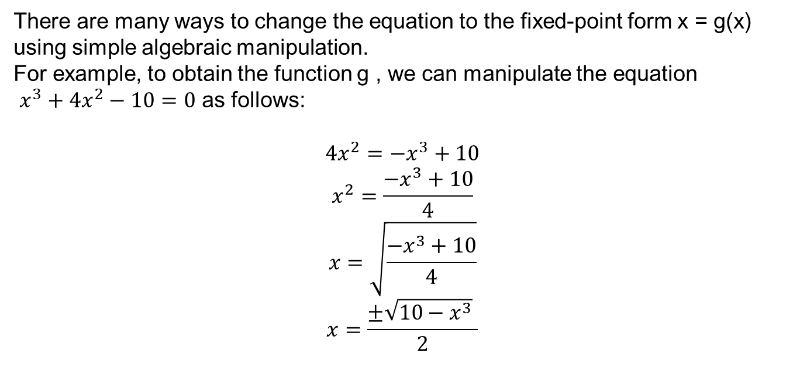

Fixed point method
A fixed point for a function is a number at which the value of the function does not change when the function is applied.
The number p is a fixed point for a given function g if g( p) = p.
$$Example$$
$$x^{3}+4x^{2}−10=0$$
has a unique root in [1, 2]. Its value is approximately 1.365230013.
There are many ways to change the equation to the fixed-point form x = g(x) using simple algebraic manipulation.
For example, to obtain the function g , we can manipulate the equation
$x^{3}+4x^{2}−10=0$ as follows:
$$4x^{2}={−x}^{3}+10$$
$$x^{2}=\frac{{−x}^{3}+10}{4}$$
$$x=\sqrt{\frac{{−x}^{3}+10}{4}}$$
$$x=\frac{±\sqrt{{10−x}^{3}} }{2}$$

Slide 3
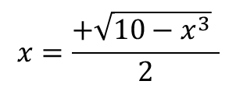
$$x=\frac{+\sqrt{{10−x}^{3}} }{2}$$
n | x
0 | 0
1 | 1.58113883
2 | 1.229547978
3 | 1.426637992
4 | 1.331950587
5 | 1.381755824
6 | 1.356639585
7 | 1.369593392
8 | 1.362987143
9 | 1.36637591
10 | 1.36464274
11 | 1.365530512
12 | 1.365076127
13 | 1.365308786
14 | 1.365189682
15 | 1.365250661
16 | 1.365219443
17 | 1.365235425
18 | 1.365227243
19 | 1.365231432
20 | 1.365229287

Slide 4


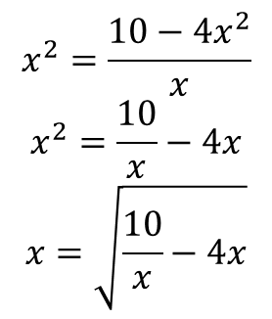

Fixed point method ( alternative arrangement )
$$x^{3}+4x^{2}−10=0$$
$$x^{3}=10−4x^{2}$$
$$x^{2}x=10−4x^{2}$$
$$x^{2}=\frac{10−4x^{2}}{x}$$
$$x^{2}=\frac{10}{x}−4x$$
$$x=\sqrt{\frac{10}{x}−4x}$$
n | x
0 | 1.5
1 | 0.816496581
2 | 2.996908806
3 | complex

Slide 5

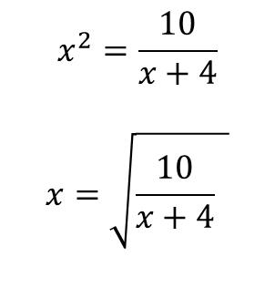
n | x
0 | 0
1 | 1.58113883
2 | 1.338562294
3 | 1.368635632
4 | 1.364796925
5 | 1.365285118
6 | 1.365223002
7 | 1.365230905
8 | 1.3652299
9 | 1.365230028
10 | 1.365230012
11 | 1.365230014
12 | 1.365230013
13 | 1.365230013
14 | 1.365230013
15 | 1.365230013
16 | 1.365230013
17 | 1.365230013
18 | 1.365230013
19 | 1.365230013
20 | 1.365230013
Fixed point method ( alternative arrangement )
$$x^{3}+4x^{2}−10=0$$
$$x^{2}\left(x+4\right)=10$$
$$x^{2}=\frac{10}{x+4}$$
$$x=\sqrt{\frac{10}{x+4} }$$

Slide 6
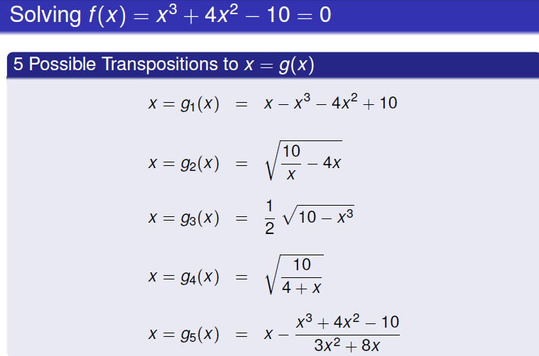

Slide 7
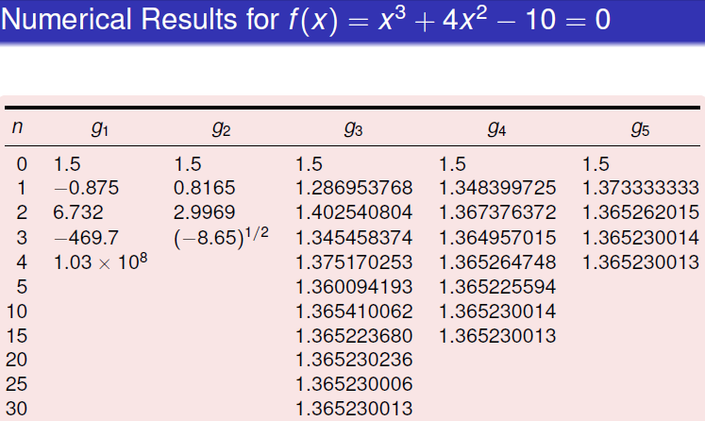

Slide 8
Solutions of Equations in One Variable Fixed-Point Iteration
it is important not to lose sight of our prime objective:
Given a function f (x) where a ≤ x ≤ b, find values p such that f (p) = 0
Given such a function, f (x), we now construct an auxiliary function g(x) such that
p = g(p)
Whenever f (p) = 0 (this construction is not unique).
The problem of finding p such that p = g(p) is known as the fixed point problem.

Slide 9
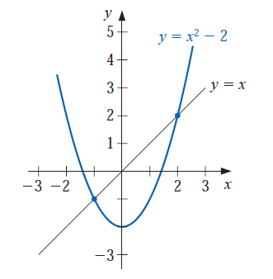
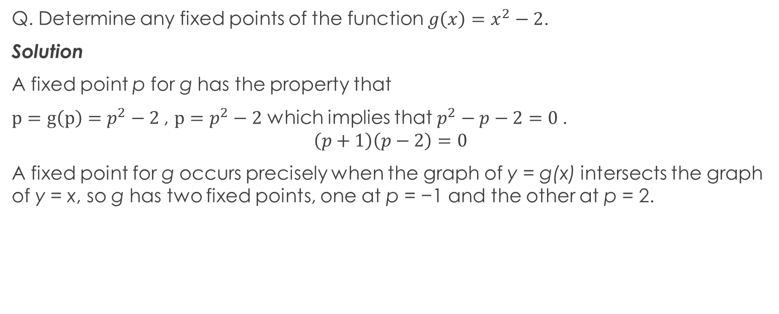
Definition : The number p is a fixed point for a given function g if g( p) = p.
Q. Determine any fixed points of the function $g\left(x\right)=x^{2}−2$.
Solution
A fixed point p for g has the property that
$p=g\left(p\right)=p^{2}−2$, $p=p^{2}−2$ which implies that $p^{2}−p−2=0$.
$$\left(p+1\right)\left(p−2\right)=0$$
A fixed point for g occurs precisely when the graph of y = g(x) intersects the graph of y = x, so g has two fixed points, one at p = −1 and the other at p = 2.

Slide 10
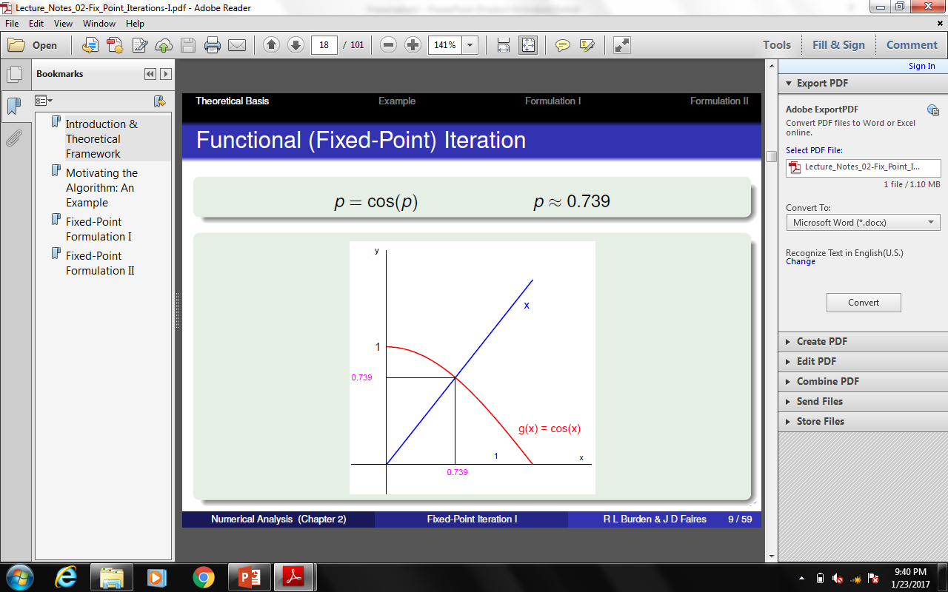
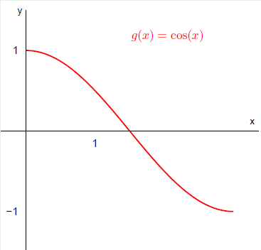

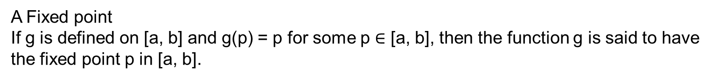
A Fixed point
If g is defined on [a, b] and g(p) = p for some p $∈$ [a, b], then the function g is said to have the fixed point p in [a, b].
The Equation f (x) = x − cos(x) = 0
If we write this equation in the form:
x = cos(x)
then g(x) = cos(x).
n | x
0 | 0
1 | 1
2 | 0.540302
3 | 0.857553
4 | 0.65429
5 | 0.79348
6 | 0.701369
7 | 0.76396
8 | 0.722102
9 | 0.750418
10 | 0.731404
11 | 0.744237
12 | 0.735605
13 | 0.741425
14 | 0.737507
15 | 0.740147
16 | 0.738369
17 | 0.739567
18 | 0.73876
19 | 0.739304
20 | 0.738938

Slide 11
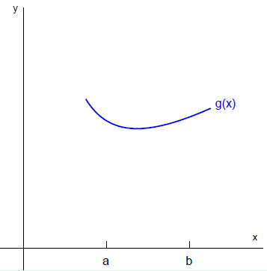
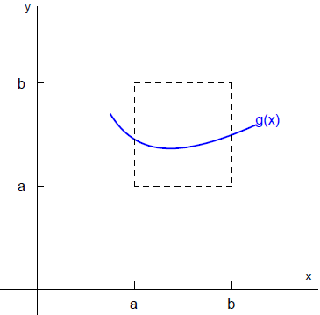


Theorem
(i) If g ∈ C[a, b] and g(x) ∈ [a, b] for all x ∈ [a, b], then g has at least one fixed point in [a, b].
(ii) If, in addition, g’(x) exists on (a, b) and a positive constant k < 1 exists with
|g’(x)| ≤ k, for all x ∈ (a, b),
then there is exactly one fixed point in [a, b].
g(x) is define on [a,b]
g(x) $∈$ [a, b] for all x $∈$ [a, b]
g(x) has a Fixed Point in [a, b]

Slide 12
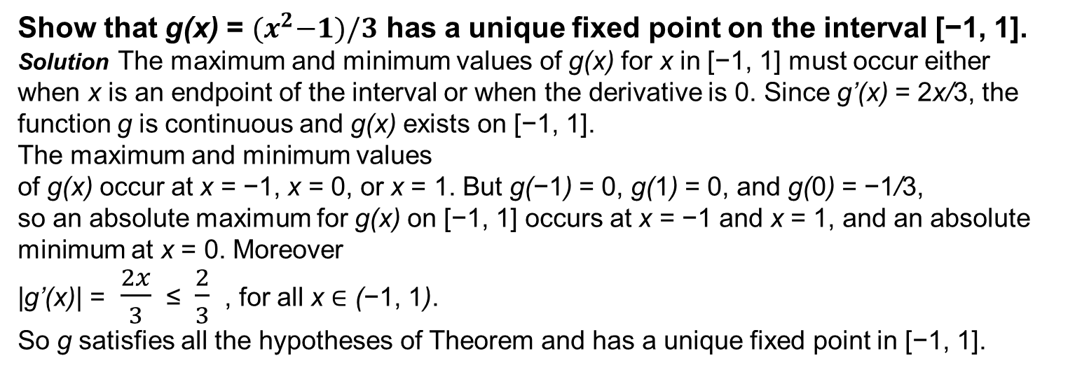
Show that g(x) = ${(x}^{2}−1)/3$ has a unique fixed point on the interval [−1, 1].
Solution The maximum and minimum values of g(x) for x in [−1, 1] must occur either
when x is an endpoint of the interval or when the derivative is 0. Since g’(x) = 2x/3, the
function g is continuous and g(x) exists on [−1, 1].
The maximum and minimum values
of g(x) occur at x = −1, x = 0, or x = 1. But g(−1) = 0, g(1) = 0, and g(0) = −1/3,
so an absolute maximum for g(x) on [−1, 1] occurs at x = −1 and x = 1, and an absolute
minimum at x = 0. Moreover
|g’(x)| =$\frac{2x}{3}$≤ $\frac{2}{3}$ , for all x ∈ (−1, 1).
So g satisfies all the hypotheses of Theorem and has a unique fixed point in [−1, 1].

Slide 13
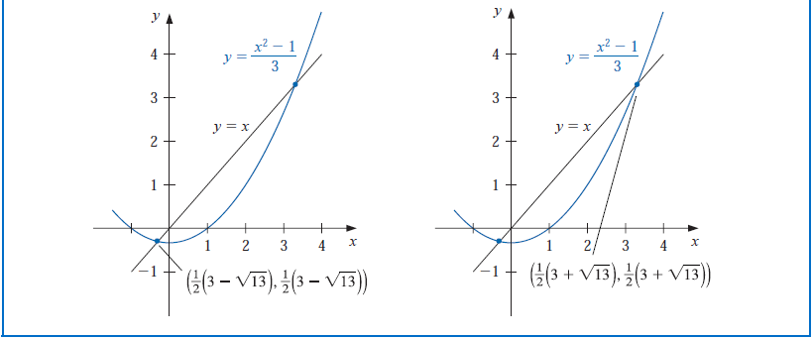
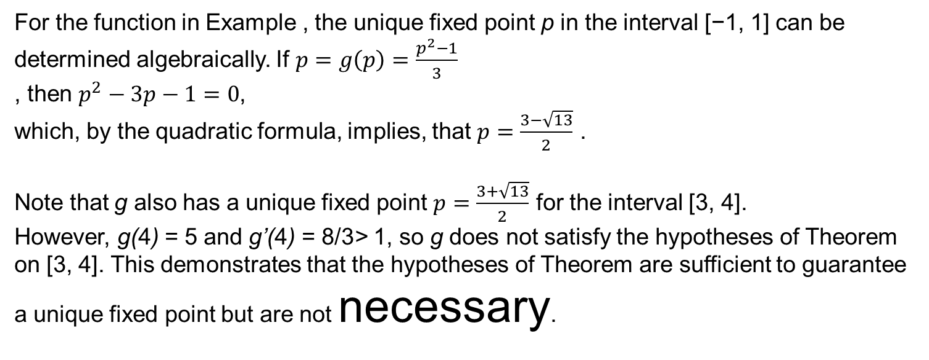
For the function in Example , the unique fixed point p in the interval [−1, 1] can be
determined algebraically. If $p=g\left(p\right)=\frac{p^{2}−1}{3}$
, then $p^{2}−3p−1=0$,
which, by the quadratic formula, implies, that $p=\frac{3−\sqrt{13}}{2}$ .
Note that g also has a unique fixed point $p=\frac{3+\sqrt{13}}{2}$ for the interval [3, 4].
However, g(4) = 5 and g’(4) = 8/3> 1, so g does not satisfy the hypotheses of Theorem
on [3, 4]. This demonstrates that the hypotheses of Theorem are sufficient to guarantee
a unique fixed point but are not necessary.

Slide 14
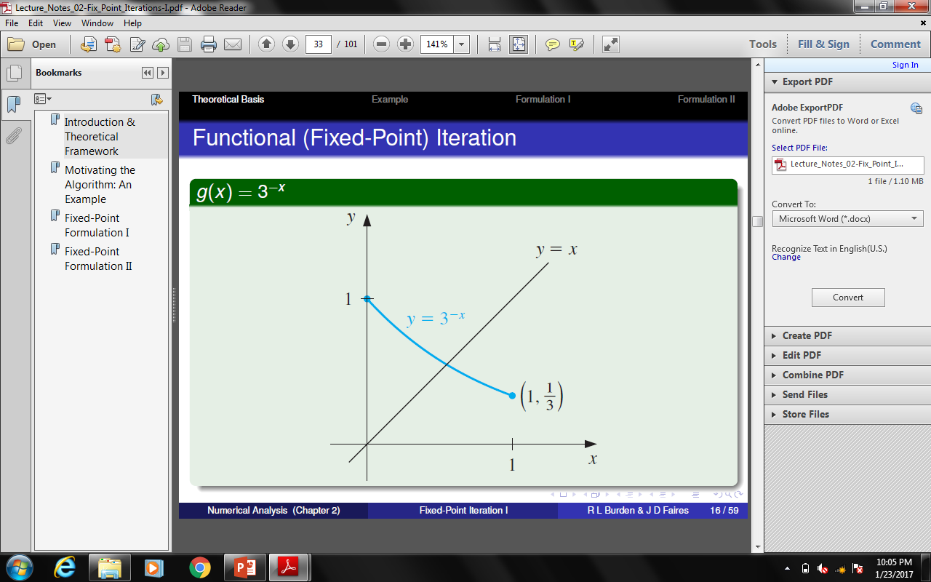
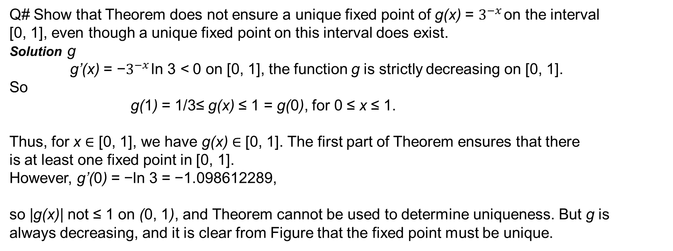
Q# Show that Theorem does not ensure a unique fixed point of g(x) = $3^{−x}$ on the interval
[0, 1], even though a unique fixed point on this interval does exist.
Solution g
g’(x) = −$3^{−x}$ ln 3 < 0 on [0, 1], the function g is strictly decreasing on [0, 1].
So
g(1) = 1/3≤ g(x) ≤ 1 = g(0), for 0 ≤ x ≤ 1.
Thus, for x ∈ [0, 1], we have g(x) ∈ [0, 1]. The first part of Theorem ensures that there
is at least one fixed point in [0, 1].
However, g’(0) = −ln 3 = −1.098612289,
so |g(x)| not ≤ 1 on (0, 1), and Theorem cannot be used to determine uniqueness. But g is
always decreasing, and it is clear from Figure that the fixed point must be unique.

Slide 15
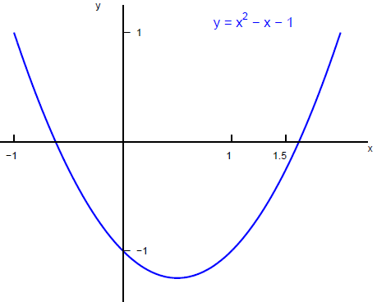
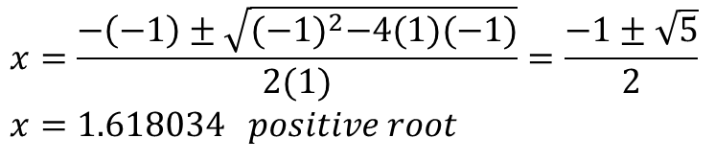

Model Example:
Consider the quadratic equation:
$x^{2}−x−1=0$
$$x=\frac{−\left(−1\right)±\sqrt{{(−1)}^{2}−4(1)(−1)}}{2(1)}=\frac{−1±\sqrt{5}}{2}$$
$$x=1.618034 positive root$$

Slide 16
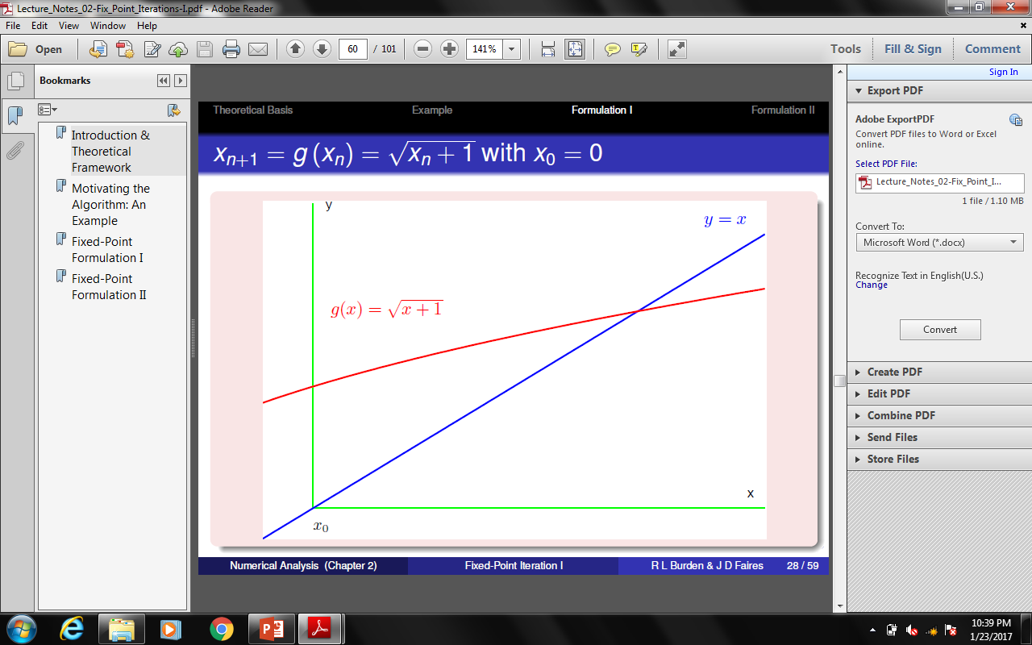
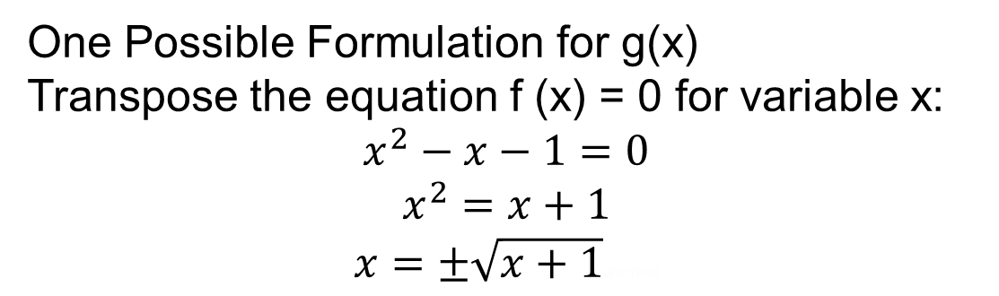
One Possible Formulation for g(x)
Transpose the equation f (x) = 0 for variable x:
$$x^{2}−x−1=0$$
$$x^{2}=x+1$$
$x=±\sqrt{x+1}$umerical

Slide 17
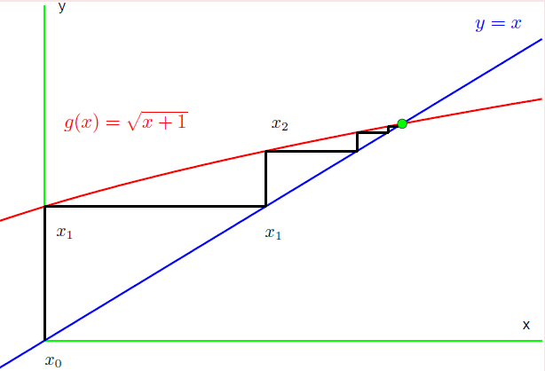
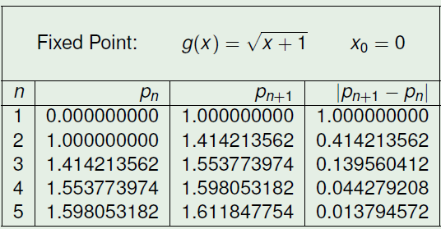

Slide 18
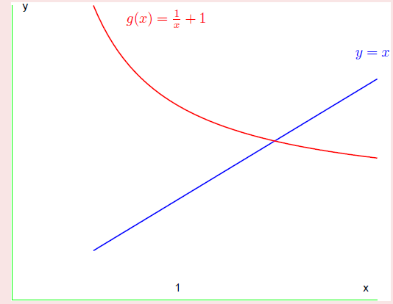

Transpose the equation f (x) = 0 for variable x:
$$x^{2}−x−1=0$$
$$x^{2}=x+1$$
$$x=1+\frac{1}{x}$$

Slide 19
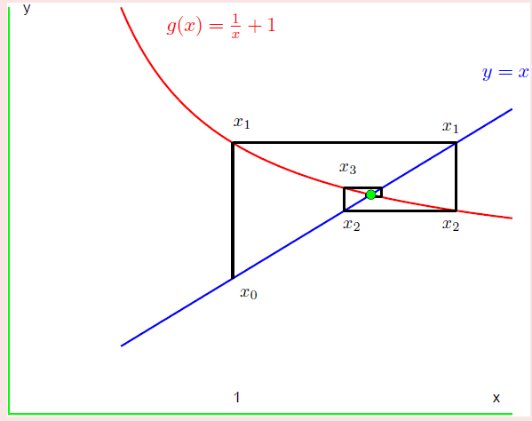
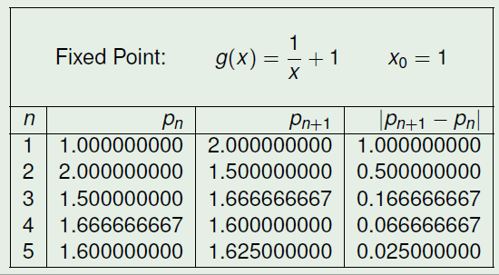

Slide 20
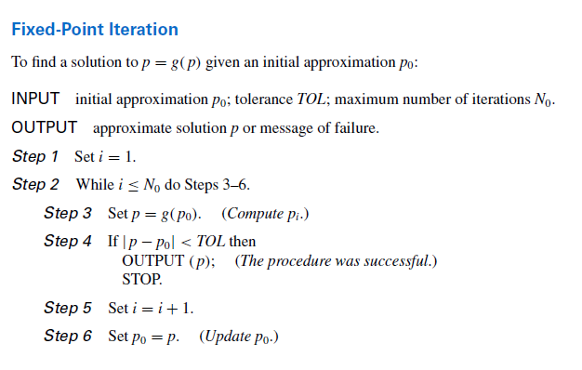

Slide 21
